Slide 1
Exploring Changes in Canada’s Birth Rate
Between 1960 – 2015
Nandita Alva

Slide 2
Dataset
I have used the World Development Indicators Dataset.

Slide 3
Motivation
In this project, I am investigating the changes in the Birth Rate in Canada between 1960 – 2015.
Over the last few decades, Canada has enjoyed unbridled economic growth; I will evaluate the correlation between changes in the Canadian GDP, demographics of labour force participation & the Birth rate.
Usefulness of the Insights:
The insights obtained here will be useful for resource planning around population growth in the coming decade.
For example, having a strong understanding of the current the Birth rate will help Governments accurately provision resources in the early childhood sector.
Insights of the Birth Rate of the previous decade allows resource planning for this cohort as they enter the school & tertiary education systems.
Insights showing unsustainable falls in birth rate driven by changes in female labour force participation, will inform policies decisions that support families & in particular working mothers wanting to have children.

Slide 4
Research Question
I want to investigate how the Birth Rate in Canada has changed between 1960-2015.
I want to investigate if there is any correlation between changes in the Canadian GDP and Birth Rate over the 1960 – 2015 time frame.
I will look at how changes in female workforce participation over time has impacted the Birth rate in Canada.
I will also evaluate if Canada’s Birth rate in recent years aligns with that of other industrialised nations.

Slide 5
Findings
<Feel free to replicate this slide to show multiple findings>
Present your findings. Include at least one visualization in your presentation (feel free to include more). The visualization should be honest, accessible, and elegant for a general audience.
You need not come to a definitive conclusion, but you need to say how your findings relate back to your research question.

Slide 6
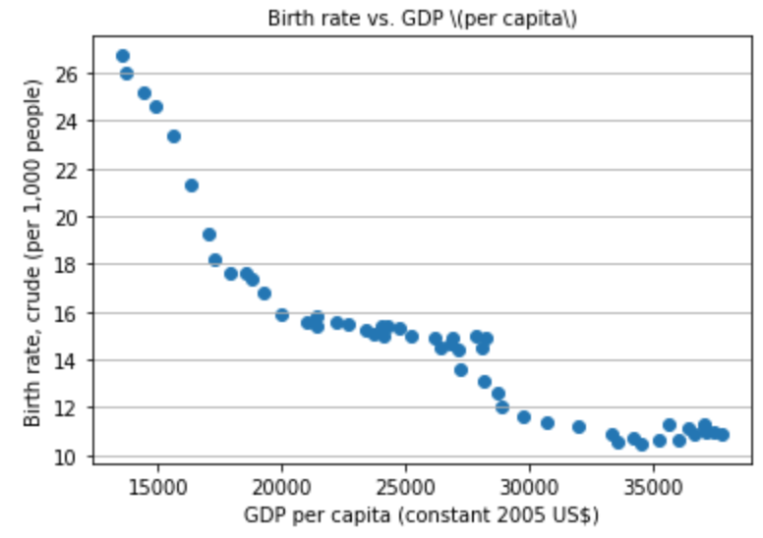
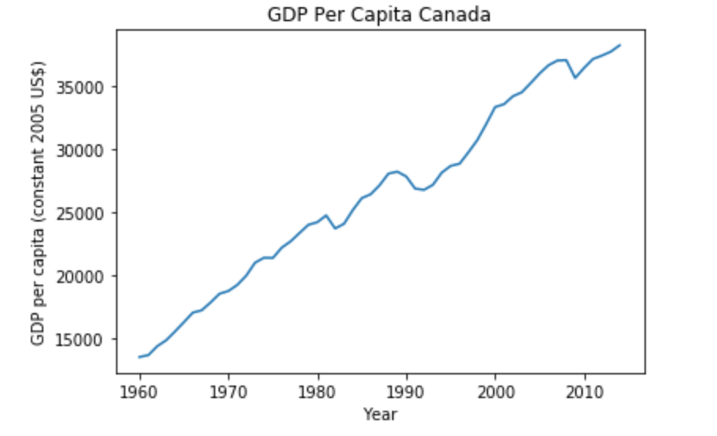
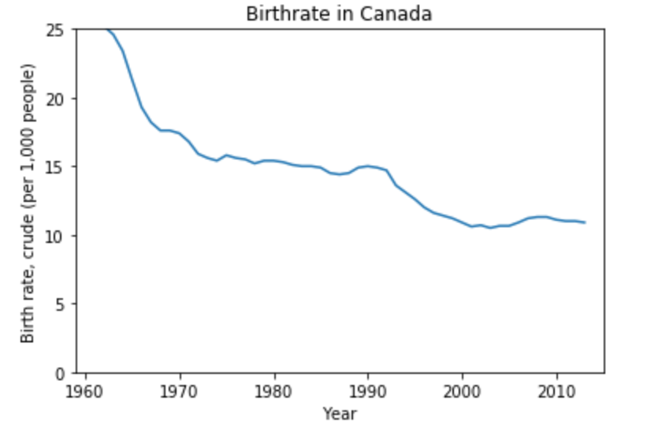
Findings: Birth rate & GDP are strongly Negatively Correlated.
The Birth rate per capita in Canada has fallen continuously in all of the last 4 decades. It fell from a high of 25 in the early1960’s (Baby Boom) to its present level of ~11 in 2015.
Concurrently, Canada has seen steep, unbridled economic growth over this same time period. A correlation coefficient analysis showed the two indicators were strongly negatively correlated at 90%.

Slide 7
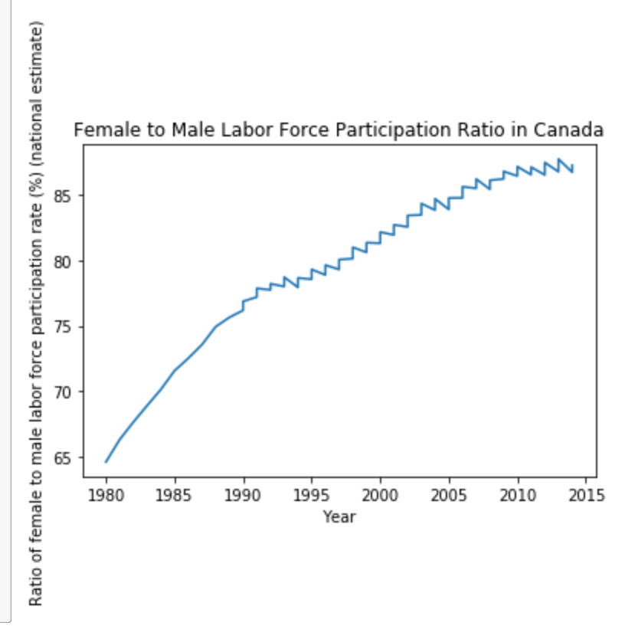
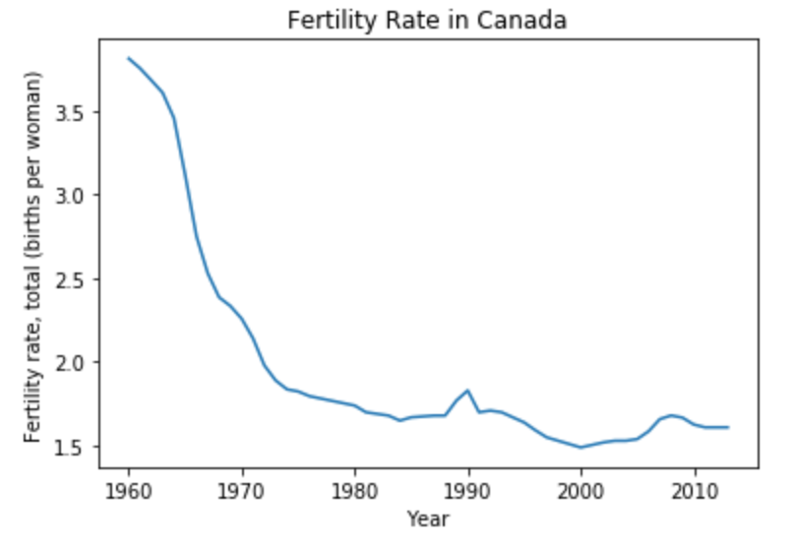
Findings: Falls in Birth Rate coincide with a rise in Female Labour Force Participation.
The economic development of the last 4 decades described in the previous slide, meant more job vacancies & employment opportunities arose for women.
We saw in an increase in the female to male labour participation ratio from 0.65 in the 1960s up to ~0.90 in recent years.
The increasing proportion of working mothers could no-longer raise large families like their stay-at-home counterparts. This brought down the fertility rate (births per women) from ~4 to just around ~1.5 children.

Slide 8
Findings:
Canada’s Birth rate rose significantly in the post-war/post-depression period between 1945-1965 (Data is only available from 1960 onwards) due to improving economic conditions. This period was characterised by more marriages & earlier marriages as compared to the war & depression years.
Over the subsequent decades, our data shows a fall in Birth rates, as more women entered the workforce, causing a preferential shift from raising large families to raising smaller families. (See previous slide).
Other reasons for this fall (but no data available to show this) is that women in the workforce were marrying at a later age (thus fertility declined naturally). Also with improving economic conditions access to birth control measures improved, decreasing unwanted births especially among adolescent and unmarried women.
A final contributor to the low birth rate in recent years (among GenY post 2011) are the rapid increases in separation and divorce rates. (Data is not available to support this, however we know this to be the case from external literature and it supports the findings of generalized fall in birth rate in this period).

Slide 9
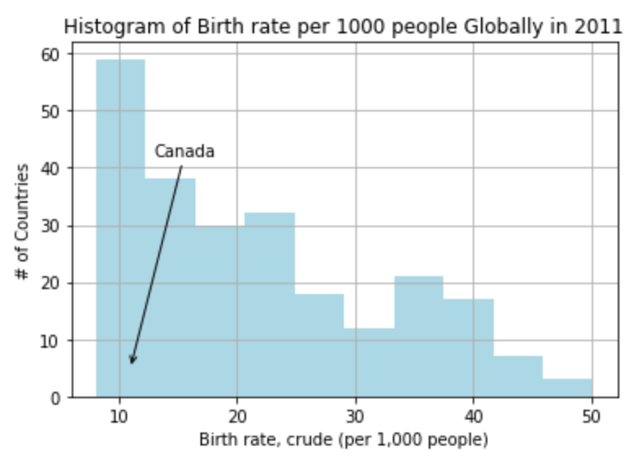
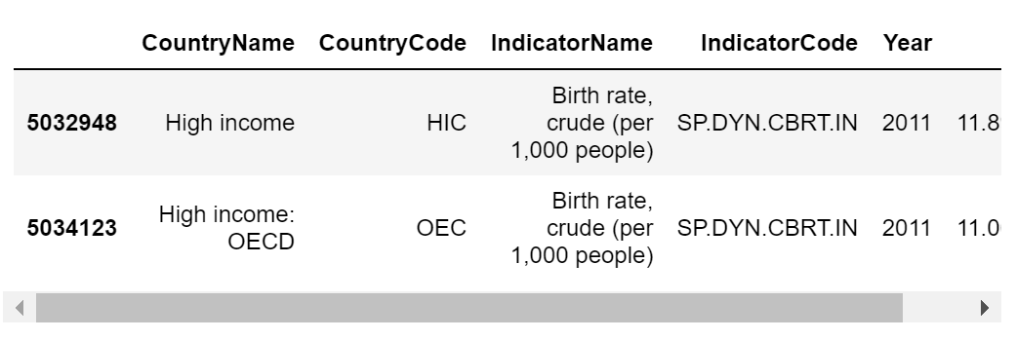
Findings:
To ascertain if Canada’s low birth rate is in line with that of other High Income Countries, I pulled up a histogram of the 2011 birth rates of all 247 countries.
The histogram showed the highest proportion of countries had birth rates under 15 and under.
In particular the high income countries of the OECD had an average of 11.0 in 2011 which is exactly in line with Canada’s birth rate in that year. Signifying that the

Slide 10
Acknowledgements
Did you use other informal analysis to inform your work? Did you get feedback on your work by friends or colleagues? Etc.
If you had no one give you feedback, it’s okay to say that.

Slide 11
References
Baby Boom .The Canadian Encyclopedia.

